Slide 1



SAE NIS EFFI-CYCLE 2019 >>>Drive The Future<<< Business Plan
19107
Samanvaya racing
IET, DAVV
Indore, Madhya Pradesh
Place College/ Team Logo within this space

Slide 2
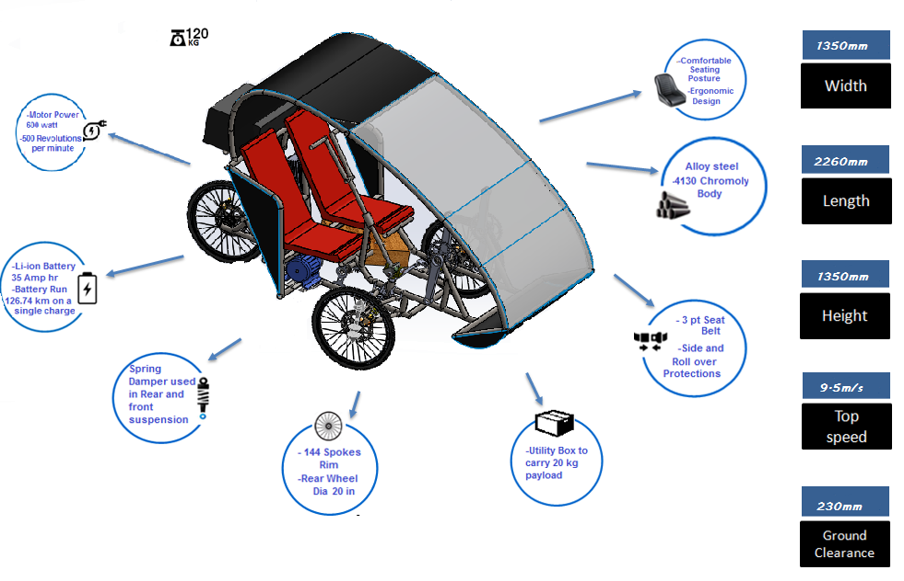
Features

Slide 3
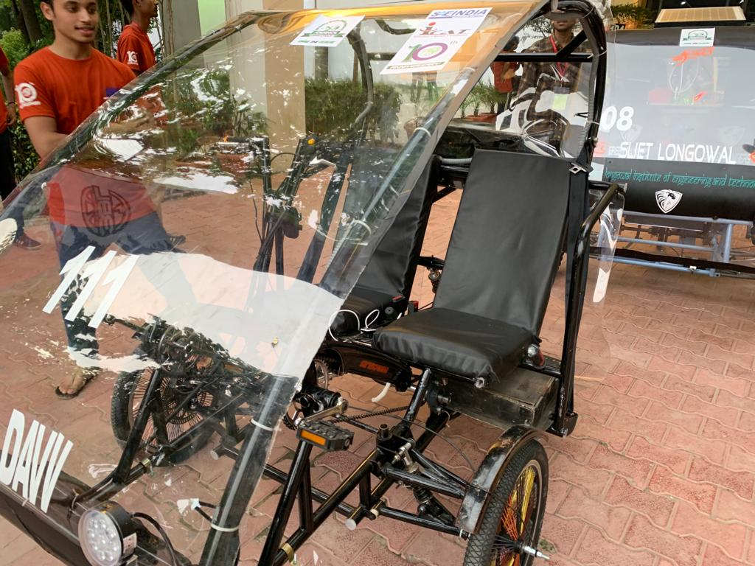
Vehicle view

Slide 4
Unique Selling Proposition
Best in class suspension for best driving experience
Hassle free ride with 0 emissions
Equipped with cutting edge technologies like solar panel
Engineered to deliver high performance
Most affordable vehicle in the segment
Health and Environment friendly
Easy to maintain
E-Electric
S-Smart
C-Comfortable
A-AeroDynamic
P-Powerful
E-Eco Friendly
Existing market competition
Mahindra e20
Okinawa Praise
Victoria Tricycle
Cost Rs8.22lakhs
4wheeler, 4seater
Cost Rs99,889
2wheeler, 2seater
Cost $2500
3wheeler, single seater

Slide 5
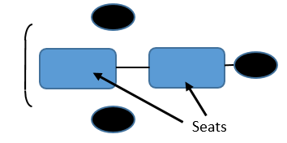
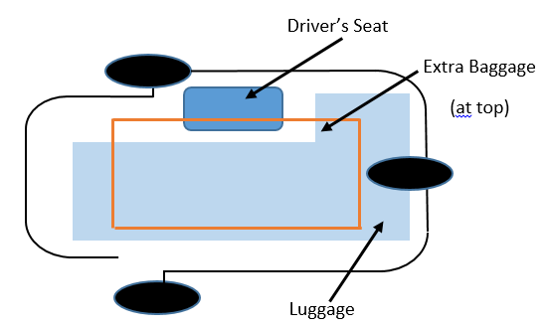
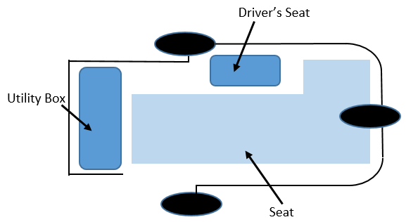
Different Concepts and Variants
Tandem design
Purpose: Chartered efficycle, numerous stations in city.
Targeted customer: 1. Environment concerned people, not using private transport.
2. Health conscious people, morning and evening workout.
Plan: Membership charges- 1. Monthly: Rs.300/- 2. Yearly: Rs.3000/-
Non-member Member
30min Rs.29/- Rs.19/-
60min Rs.49/- Rs.29/-
90min Rs.69/- Rs.45/-
For every additional 30min Rs.30/- Rs.15/-
FRIGETE
1 driver + Swivel seat + Boot on top + spacious
Purpose: Good transport, mainly for vendors.
Targeted customer: Grocery vendors.
Other customer: 1. Metro and Airport coolies.
2. Ware house.
4 seated + 1 driver + Utility box in front
Purpose: Public transport.
Targeted customer: 1. People unable to buy auto and pay fuel expenses.
2. Where eco-friendly environment is essential.
Plan: It can give it’s facility in:-
1. Tourist places.
2. Zoos and amusement parks.
3. Green resorts.

Slide 6
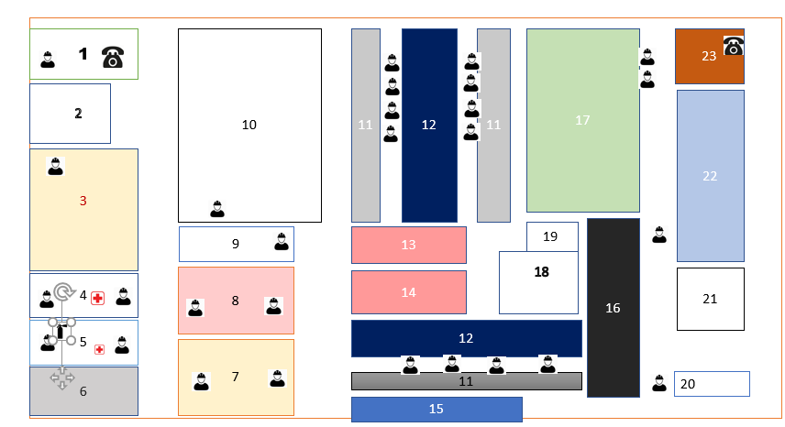
PLANT LAYOUT
Unloading section
Quality check
Raw material inventory
Machining shop
Welding shop
Compressor room
Inspection, repair and cleaning
Paint shop
Seat production
Work in process inventory
Storage bins
Assembly line
Instrumentation sectio
Innovation & regeneration section
Water tank
Track for testing
Finished product house
Canteen
Toilet
Electricity room
Store
Maintenance & repair area
Guard house

Slide 7
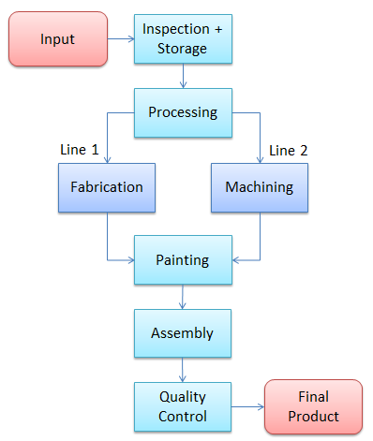
Process flow
Machinery used
Fabrication
Bend-saw
Pipe bending
TiG welding
Machining
CNC Lathe
Pillar drill machine
Tooling
Office equipment
Investment
Land+Construction(10,000sq. ft)= 0.45crore
Plant + Machinery= 0.25 crore
Raw material + Outsourcing cost= 10.95crore
Operational cost= 1.6848 crore
Total amount= 13.336 crore

Slide 8
Cost of Product in Mass Production
Cost calculation for one vehicle
Raw material= Rs19,000
Outsourced components= Rs41,000
Fabrication + Machining= Rs10,000
Painting + Assembly= Rs5,000
Office + Handling Charges= Rs4,000
Overhead expenses= Rs3,000
__________________________
Final Cost = Rs82,000 (exclusive of taxes)
Profit margin = 10%
Selling price= Rs90,200
(ex-showroom)

Slide 9
Break even Analysis
Fixed cost per product= Rs10,000
Variable cost per product= Rs72,000
Total products sold in one year= (likely)1560
Total fixed cost= Rs1,56,00,000
Contribution of one product= product cost – variable cost= Rs18,200
No. of products for Break even= total fixed cost/contribution of one product= 857
Time for break even= 7months

Slide 10
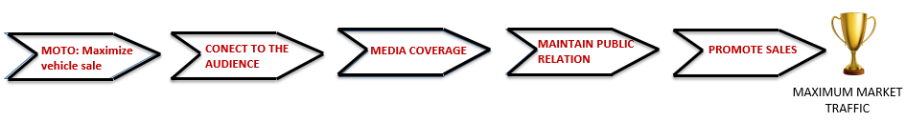
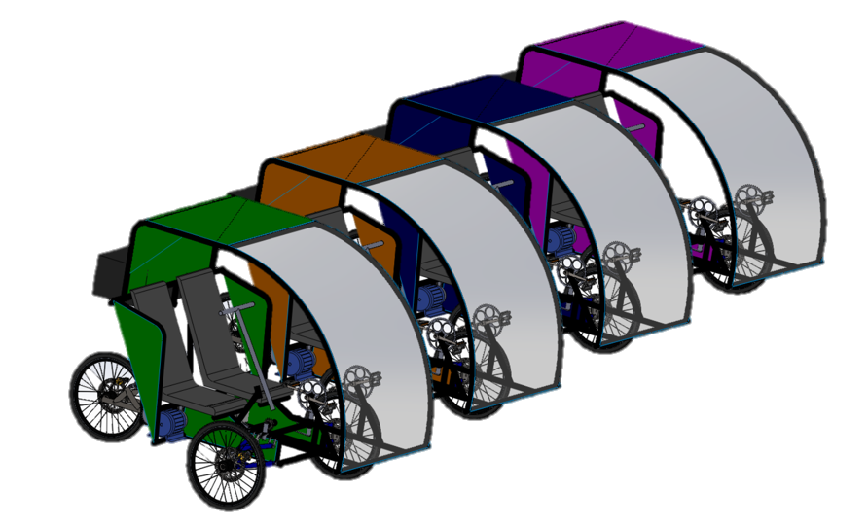
Promotional Strategies
Upgrading the vehicle every year* with latest innovations at nominal cost. (*for 3 years).
Listing the vehicle with car rental services for gaining popularity and to allow customers to experience the vehicle.
Partner With Local Institutions to Educate Students on Fitness and Eco-friendly vehicles.
Virtual Reality for Real Sales

Slide 11
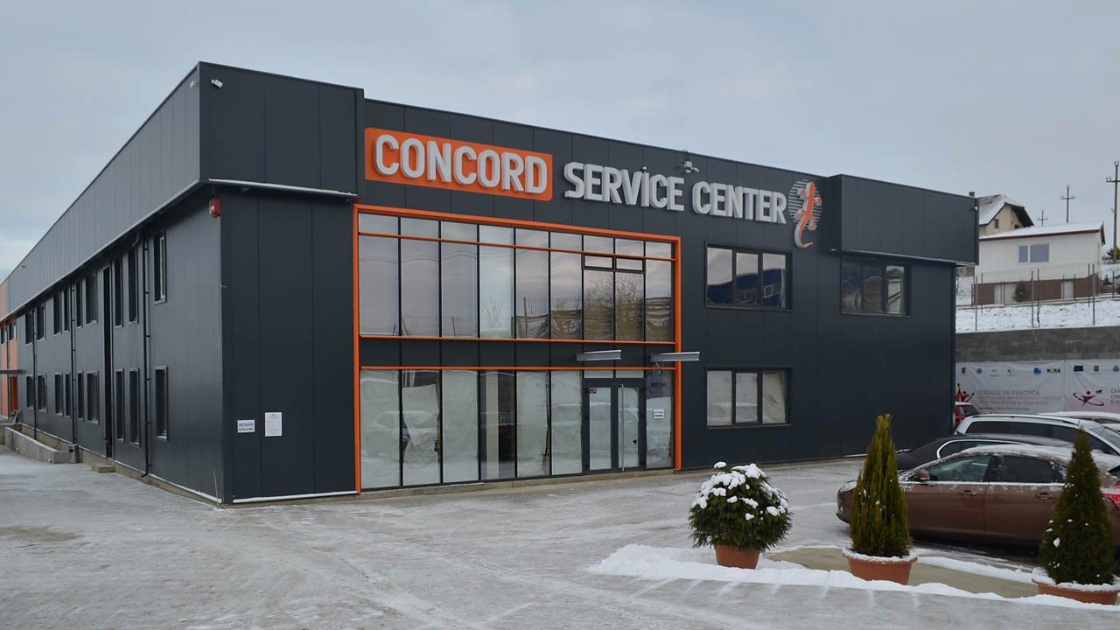
After-market Strategies
3F (First Five Free services)
Focus on the Customer Experience to Drive Loyalty
Get the Most ROI From Your Database
Use customer feedback for further innovations
Use Cloud-based Communication Tools for Outbound Marketing Calls
Reaching at least 10 touch points in local market for spares and services.
Installed Base
Lock In
EFFICYCLE

